Slide 1
Chapter 17: Indexing

Slide 2
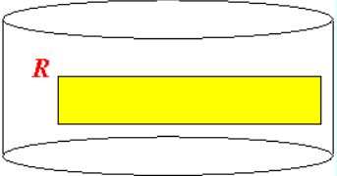
Introduction to Indexing
Consider the following query on relation stored on disk:
Storing a relation on disk:
Without further information, the only way to process the above query is:
Query:
Select *
From R
Where a = 10;
Read all blocks of the relation R
Look for tuples with a = 10

Slide 3
Definitions
More efficient processing:
Maintain additional information on specific attributes (most useful ones, e.g., key attributes) in the relation
Search key:
Search key = field(s) used to create the additional search information used to speed up a look up operation

Slide 4

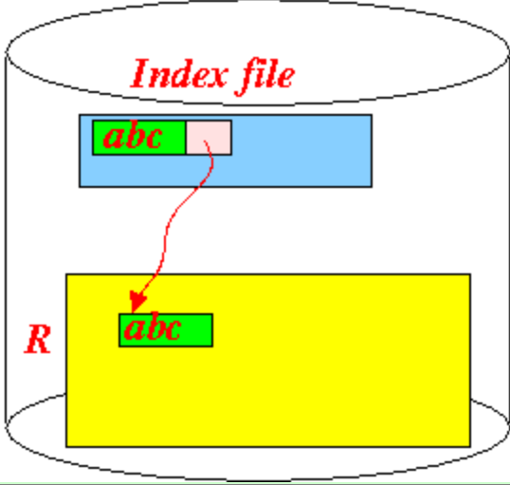
Definitions (cont.)
Index file: a file that store records of the following format:
Graphically:
The pointer is usually a block pointer
So the index allow you to locate the block that contain the record quickly
The record is found by a search operation after the block
Because the search operation only access main memory, the search is relatively quick (no disk access)

Slide 5
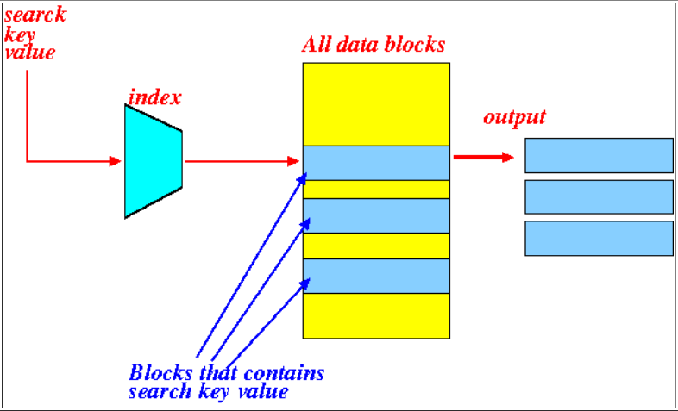
What You Can Achieve with an Index
An index will achieve this effect:
An index performs the following mapping:
Search key value =====>
List of blocks that contains the search key value

Slide 6
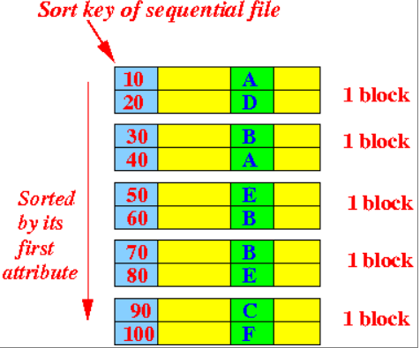
Basic Concept: Sequential File
Sequential file:
A file whose records are sorted by some attribute(s) (usually its primary key)
Example: a sequential file
Sort key:
Field(s) whose values are used to sort/order the records in a sequential file

Slide 7
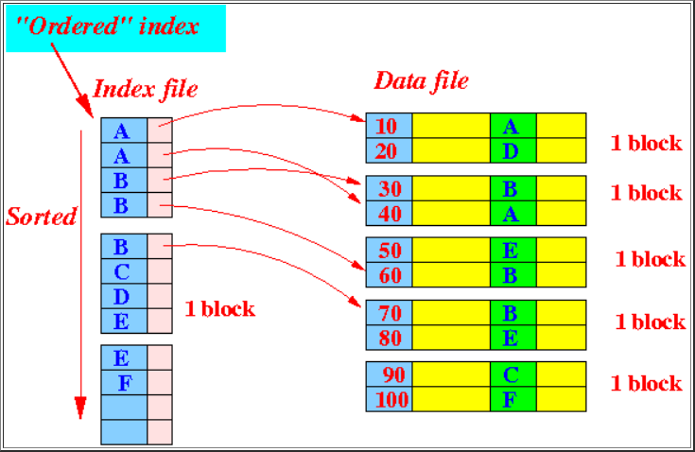
Ordered Index
Ordered index:
Ordered index = an index file where the index entries are sorted (in the order of the search key)
Example: an ordered index

Slide 8
Ordered Index (cont.)
Note:
Take sorted with a grain of salt
We will discuss B-tree that store the keys in a tree structure
There is an ordering of the keys in a B-tree, but the ordering is not sequential
See it shortly after

Slide 9
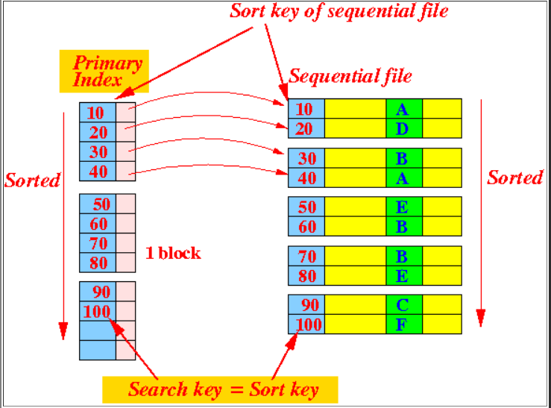
Ordered Index – Primary Index
Primary index:
An ordered index whose search key is also the sort key used for the sequential file
Example: a primary index

Slide 10
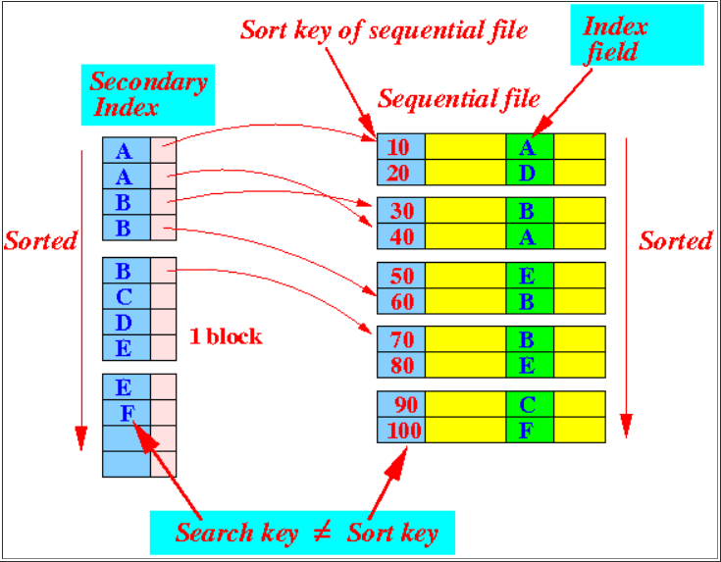
Ordered Index – Secondary Index
Secondary index:
An ordered index whose search key is NOT the sort key used for the sequential file
Example: a secondary index

Slide 11
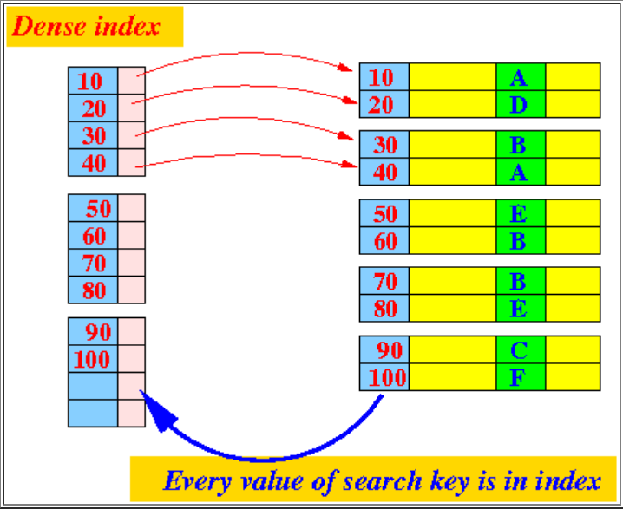
Dense and Sparse Index
Dense index:
The index file’s search entries, contain every value of the search key of the data file
Example: a dense index

Slide 12
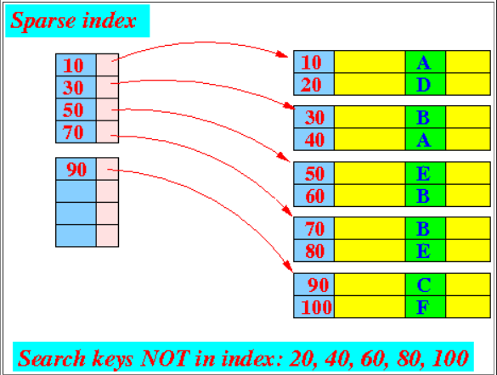

Dense and Sparse Index (cont.)
Sparse index:
The index file’s search entries, does not contain every value of the search key of the data file
The search key of a sparse index must be the sort key of the data file !!!
A sparse index contains:
One index for each data block

Slide 13
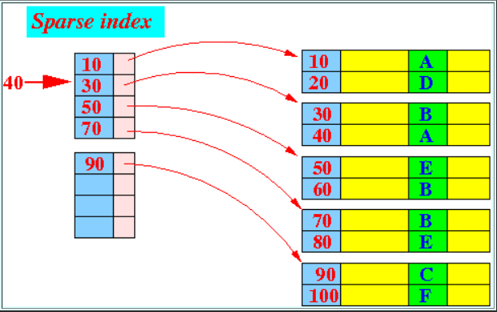
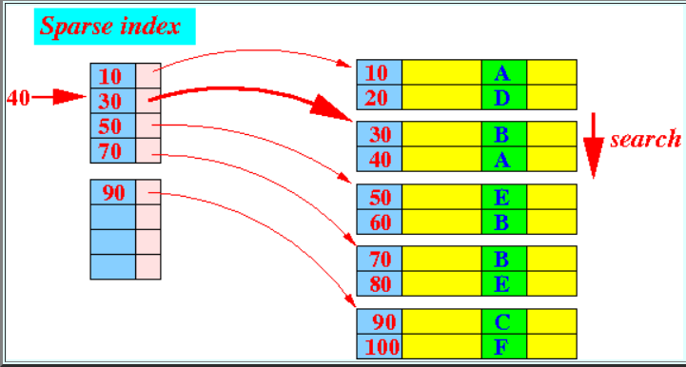
How to Use a Sparse Index
Example:
Look up the record with search key = 40
Step 1: find the search key <= 40:
Step 2: Search in the block for search key 40:

Slide 14
Multi-Level Index
Fact:
An index file is also a data file
(it contains data !!!)
Therefore:
We can create an (primary) index on an index file !!!
Result: Multi-level index....
See example:

Slide 15


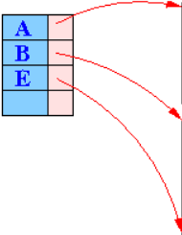
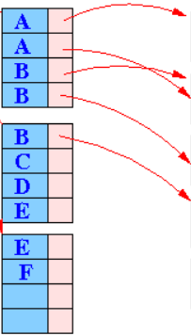
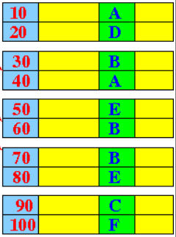
Example: A Multi-Level Index

Slide 16




How to Use a Multi-Level Index
How to find the search key = D ?

Slide 17
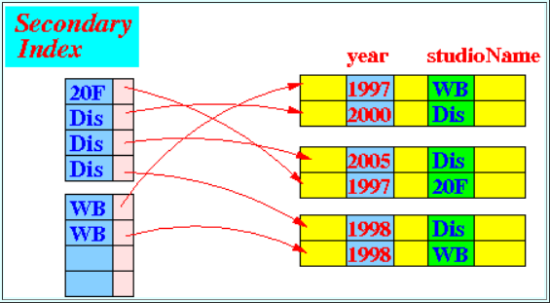
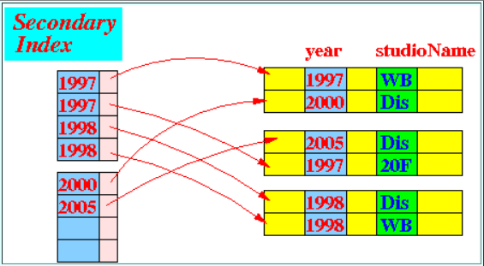
Using an Index to Answer Queries
Prelude: database definition
Database of movies
Suppose, we have:
A secondary index on studioName
A secondary index on year

Slide 18
Using an Index to Answer Queries (cont.)
Sample query:
Find movies made by Disney (Dis) in the year 2005
Process query as follows:

Slide 19
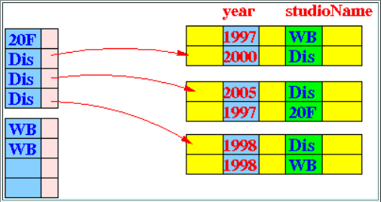
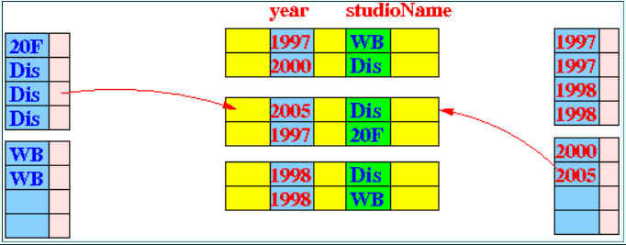
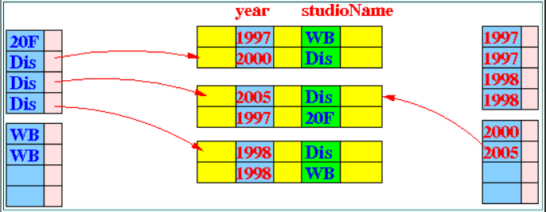
Step 1: find all pointers to records satisfying studioName = Dis
Step 2: find all pointers to records satisfying year = 2005
Step 3: compute the intersection

Slide 20
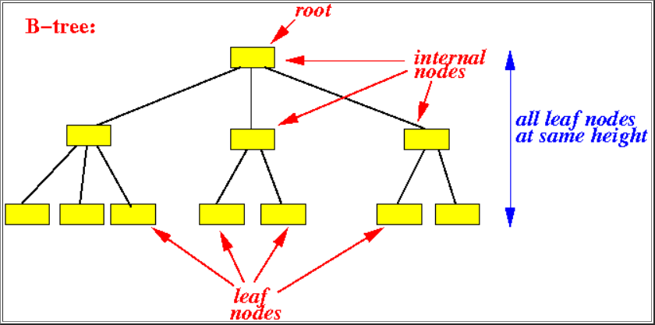
B⁺-Tree: Introduction
What is a B-tree or B⁺-tree
A dynamic multi-level index
Organized as a balanced tree structure
B⁺-tree is a height balanced tree:

Slide 21
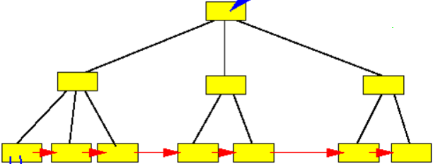
B⁺-Tree: Introduction (cont.)
What is a B-tree or B⁺-tree
A dynamic multi-level index
Organized as a balanced tree structure
B⁺-tree is a height balanced tree:

Slide 22
Difference between a B-Tree and a B⁺-Tree
B-tree:
The leaf nodes in a B-tree is not linked
We will only use B+-trees because:
It's very little effort to maintain the links in the leaf nodes
We need the ability to traverse the records in an ordered manner

Slide 23
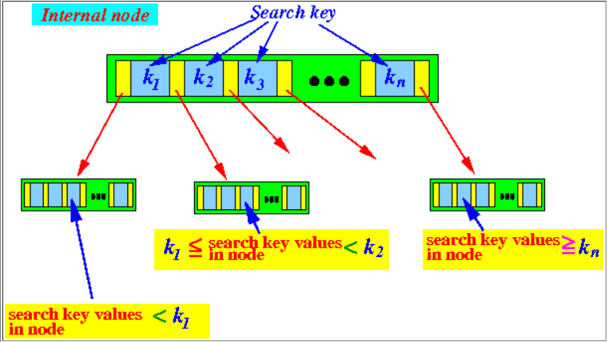


Structure of a B⁺-Tree – Internal Node
Search keys stored in an internal node satisfy the following property:

Slide 24
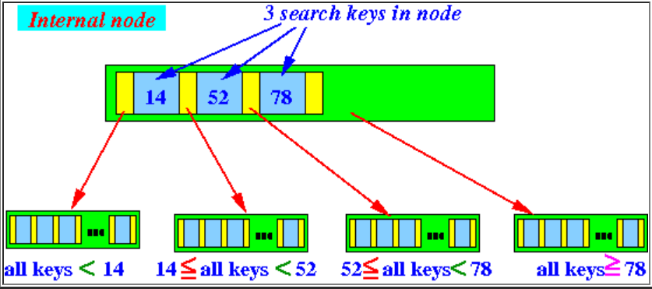
Structure of a B⁺-Tree – Internal Node (Example)
Search keys stored in an internal node satisfy the following property:

Slide 25
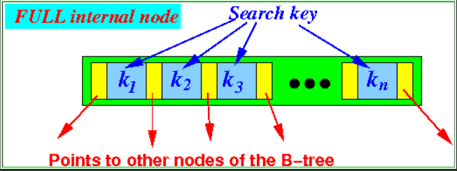
Structure of a B⁺-Tree – Internal Node (cont.)
Each internal node is stored in one block on disk
A full internal node:
A pointer in an internal node points to:

Slide 26
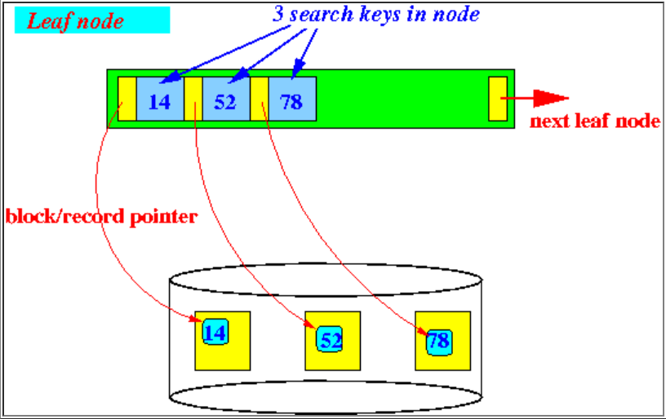

Structure of a B⁺-Tree – Leaf Node
Search keys and block/record pointer stored in an leaf node satisfy the following property:

Slide 27
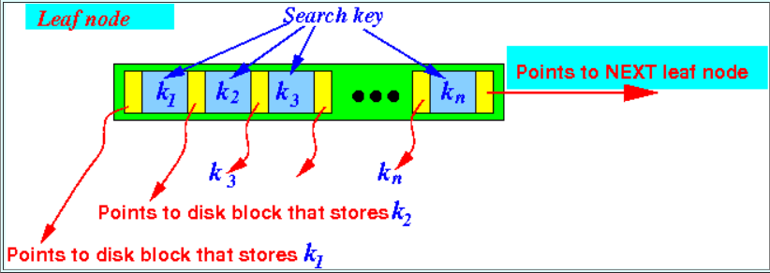
Structure of a B⁺-Tree – Leaf Node (cont.)
Each leaf node is stored in one block on disk
The last pointer points to the next leaf node (= a disk block !) in the B⁺-tree

Slide 28
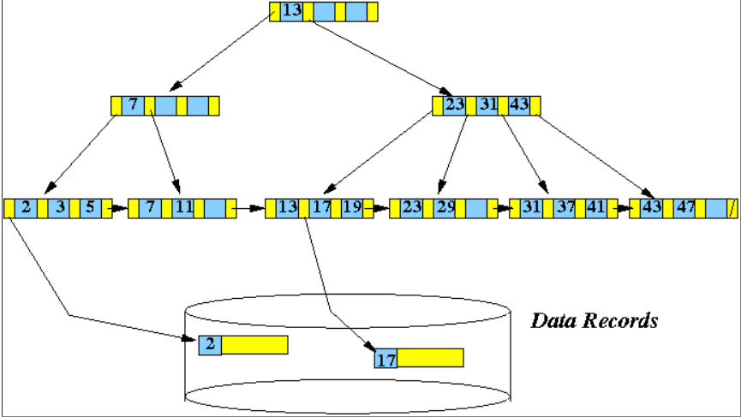
Example of a B⁺-Tree
Example B⁺-tree (with n = 3, #pointers = 4):

Slide 29
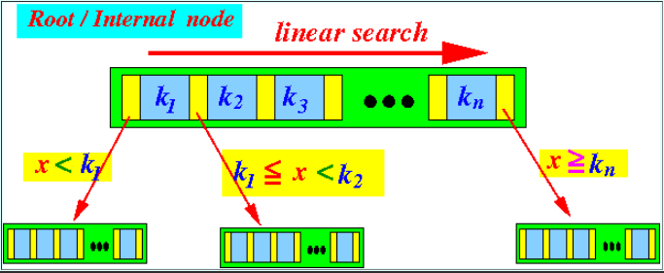
Searching in A B⁺ Tree
Search for a record with search key = x:
Step 1: start at the root node use a linear search to find the next node as follows:
Follow one of the pointers to the next node
Repeat this step as long as the next node is an internal node

Slide 30
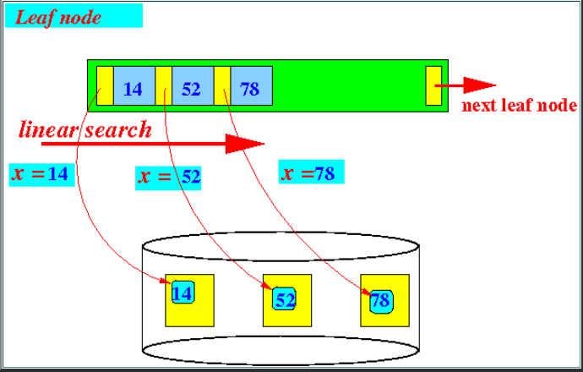
Searching in A B⁺ Tree (cont.)
When you reached a leaf node:
Search for the key = x:
If x is found:
Use the block/record pointer to fetch x
If x is not found:
Report a x not found error

Slide 31
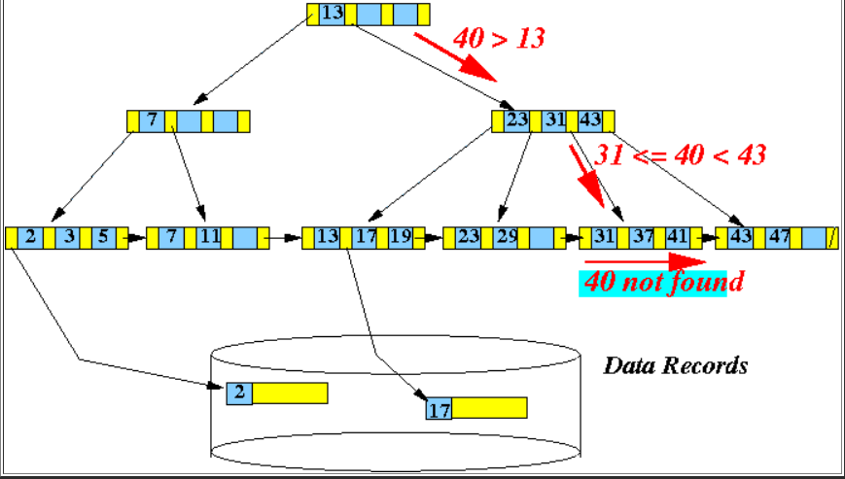
Searching in A B⁺ Tree (Example)
Example: search for search key = 40
50
80

Slide 32
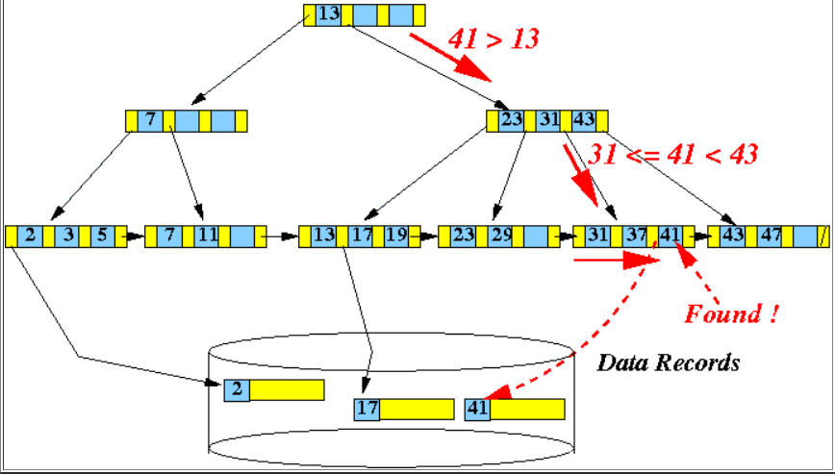
Searching in A B⁺ Tree (Example) (cont.)
Example: search for search key = 41
50
80

Slide 33
Discussion for Homework
Question: Consider a disk with the following characteristics:
Block size: B=512 bytes
Inter-block gap size: G=128 bytes
# of blocks per track: 20 ms
Average seek time: 30 ms
The disk drive rotates the disk pack at a speed of 2400 rpm
Q1: Calculate the average time it would take to transfer 20 random blocks
Solution for Q1:
1) Average seek time = 30 ms
2) Rotational latency =
3) Block Transfer time = ?

Slide 34
Discussion for Homework (cont.)
3)Transfer time = ?
We first compute transfer rate:
Transfer time per one block =
Solution:
Time to transfer 20 random blocks = 20 * (S + RL + BTT) = 20 * (30 + 12.5 + 1) = 870 ms

Slide 35
Discussion for Homework (cont.)
Question: Consider a disk with the following characteristics:
Block size: B=512 bytes
Inter-block gap size: G=128 bytes
# of blocks per track: 20 ms
Average seek time: 30 ms
The disk drive rotates the disk pack at a speed of 2400 rpm
Q2: Calculate the average time it would take to transfer transfer 20 consecutive blocks using double buffering

Slide 36
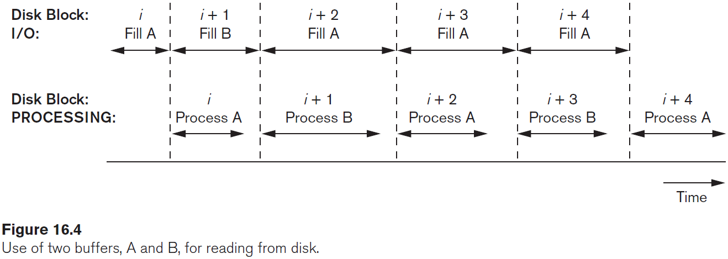
Discussion for Homework (cont.)
Solution for Q2:
1) Average seek time = 30 ms
2) Rotational latency =
3) Block Transfer time = ?

Slide 37
Discussion for Homework (cont.)
Solution for Q2:
1) Average seek time = 30 ms
2) Rotational latency = 12.5 ms
3) Block Transfer time = 1 ms
Solution:
Transfer 20 consecutive blocks using double buffering = s + rd + 20*btt = 30 + 12.5 + (20*1) = 62.5 msec

